Slide 1
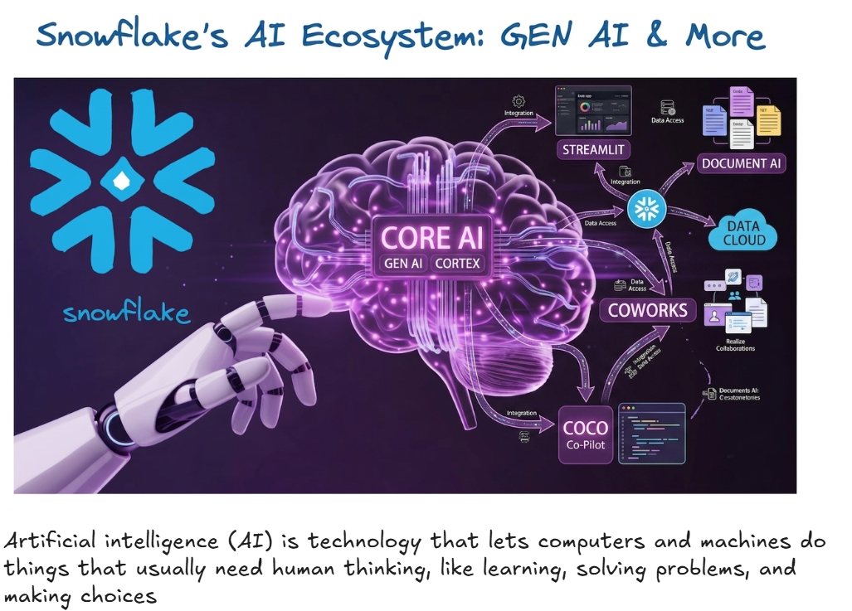

Slide 2
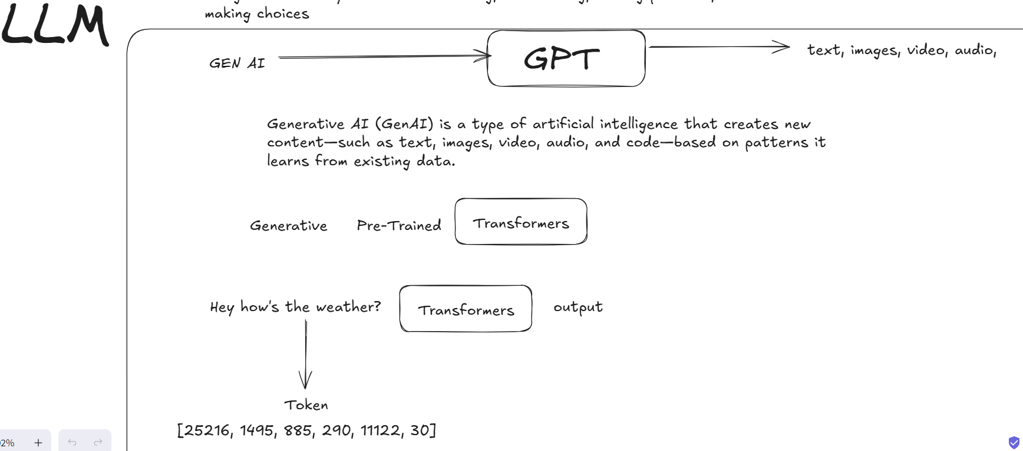

Slide 3
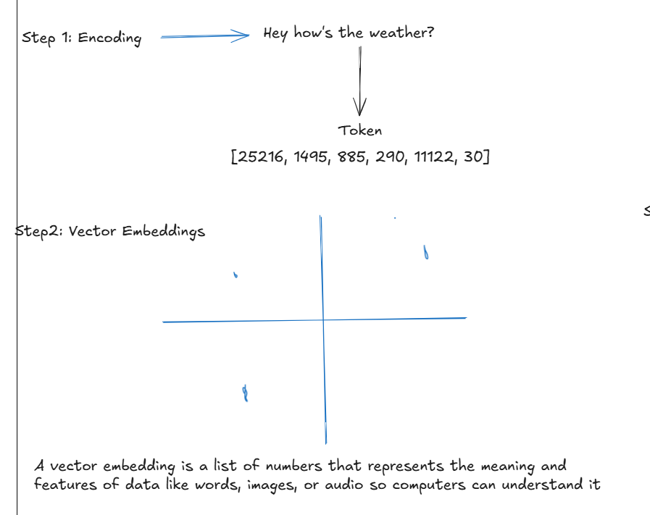

Slide 4
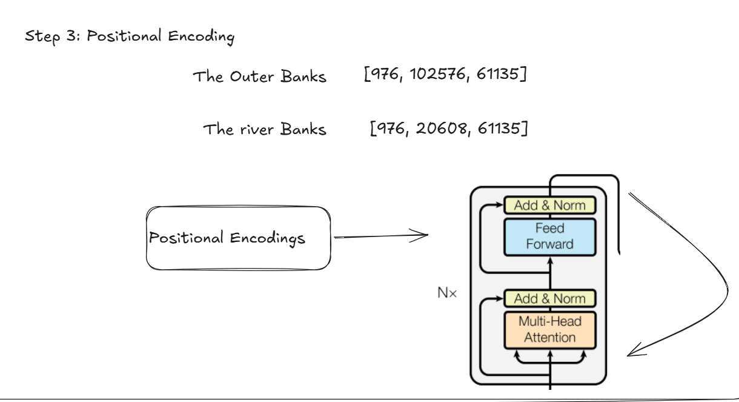

Slide 5
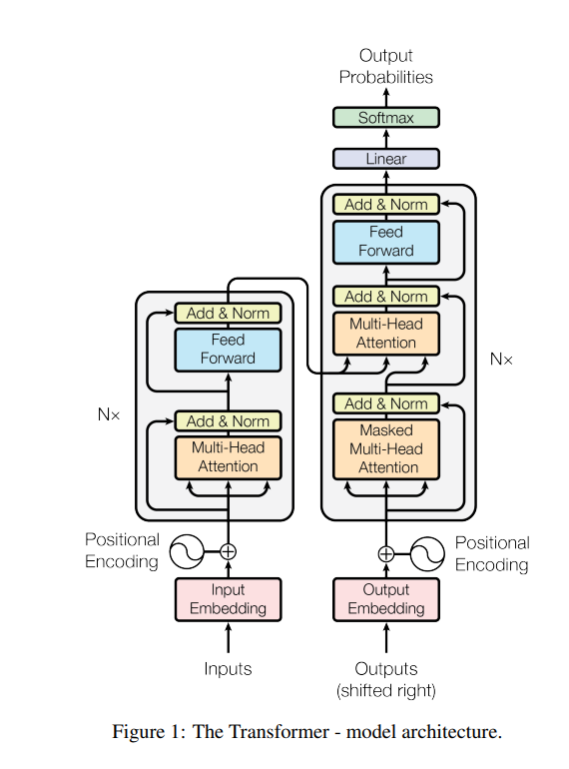
https://proceedings.neurips.cc/paper_files/paper/2017/file/3f5ee243547dee91fbd053c1c4a845aa-Paper.pdf
Attention Is All You Need

Slide 6
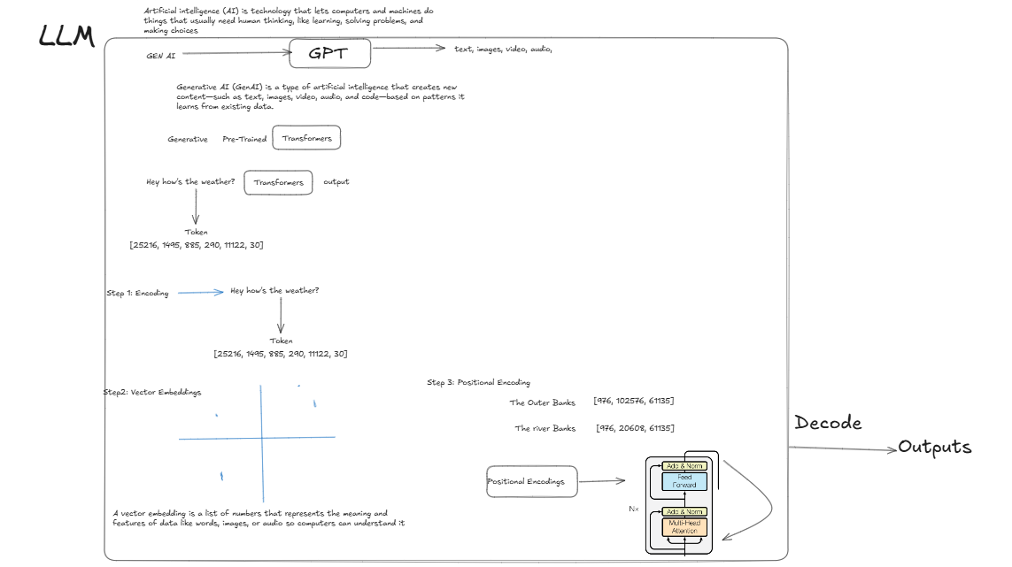

Slide 7
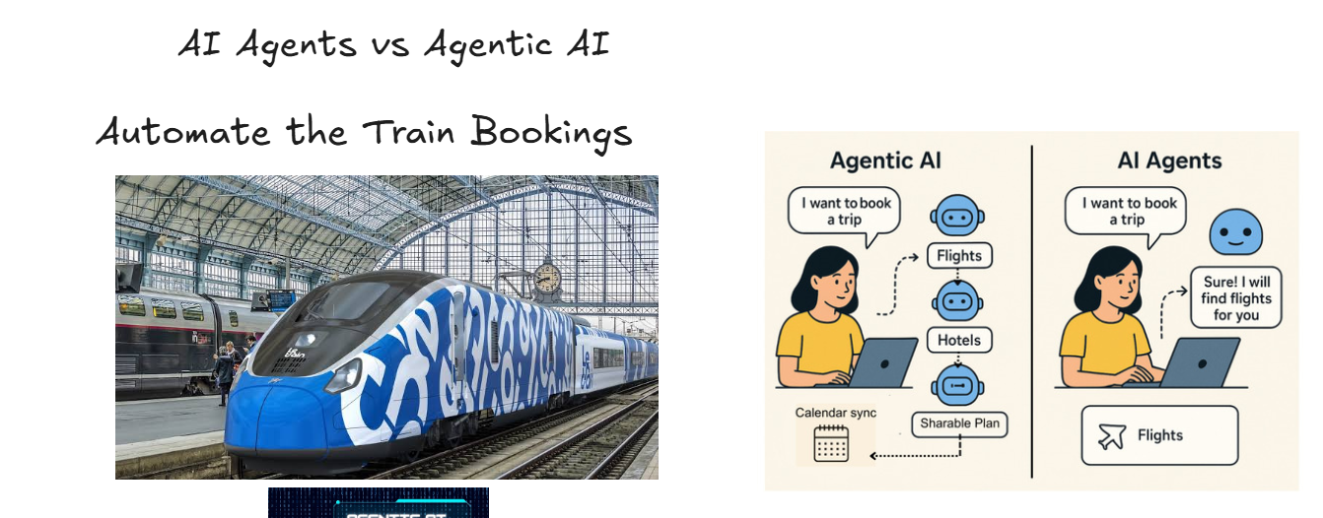

Slide 8
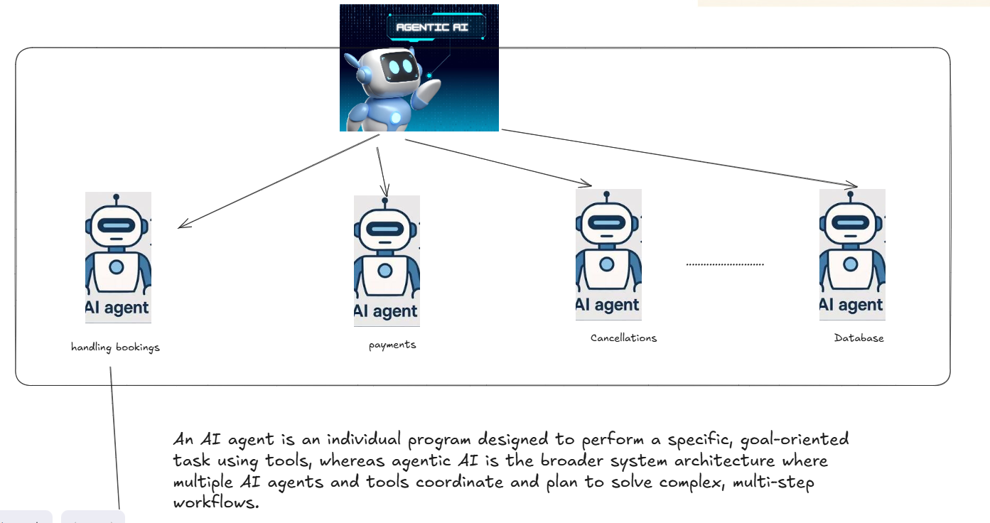

Slide 9
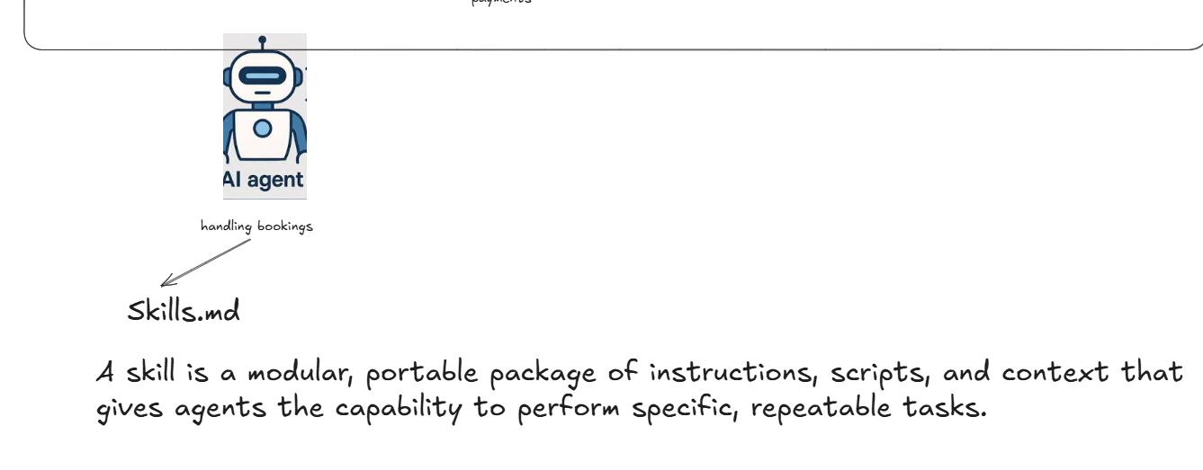

Slide 10
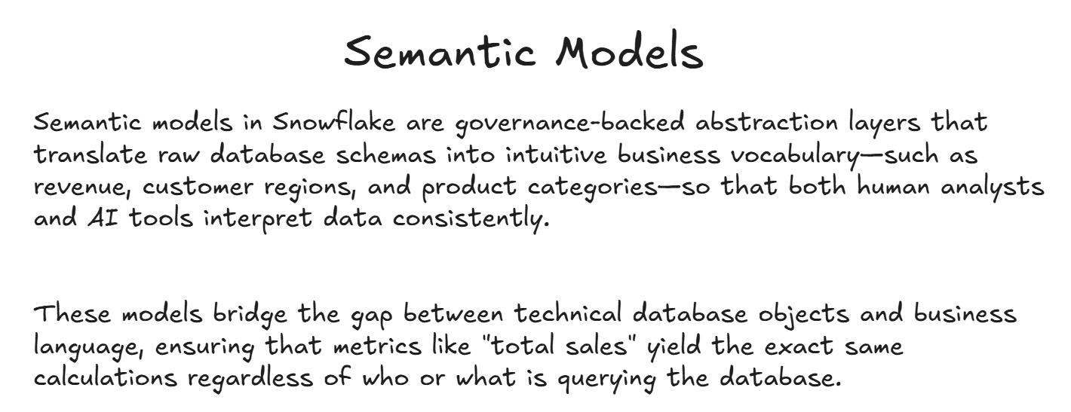

Slide 11
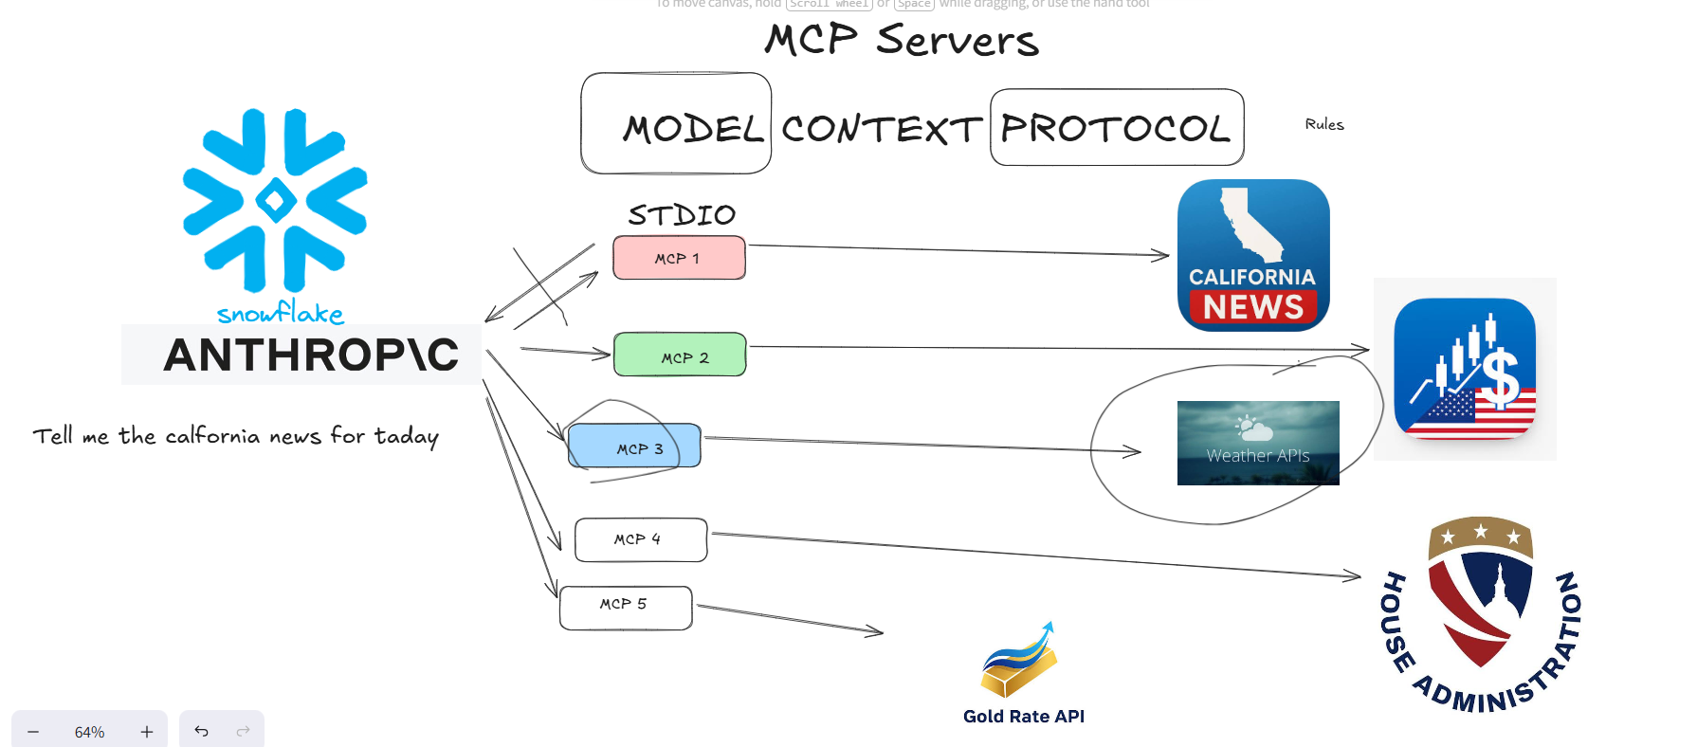
Model Context Protocol (MCP) is an open-source standard that lets AI agents securely interact with business applications and external data systems, such as databases and content repositories. MCP lets enterprise businesses reduce integration challenges and quickly deliver outcomes from models.

Slide 12
